Slide 1

Geschwister Scholl Institute of Political Science
Introductory Meeting
M.A. Political Science
Winter term 2025/26
October 2nd, 2025

Slide 2
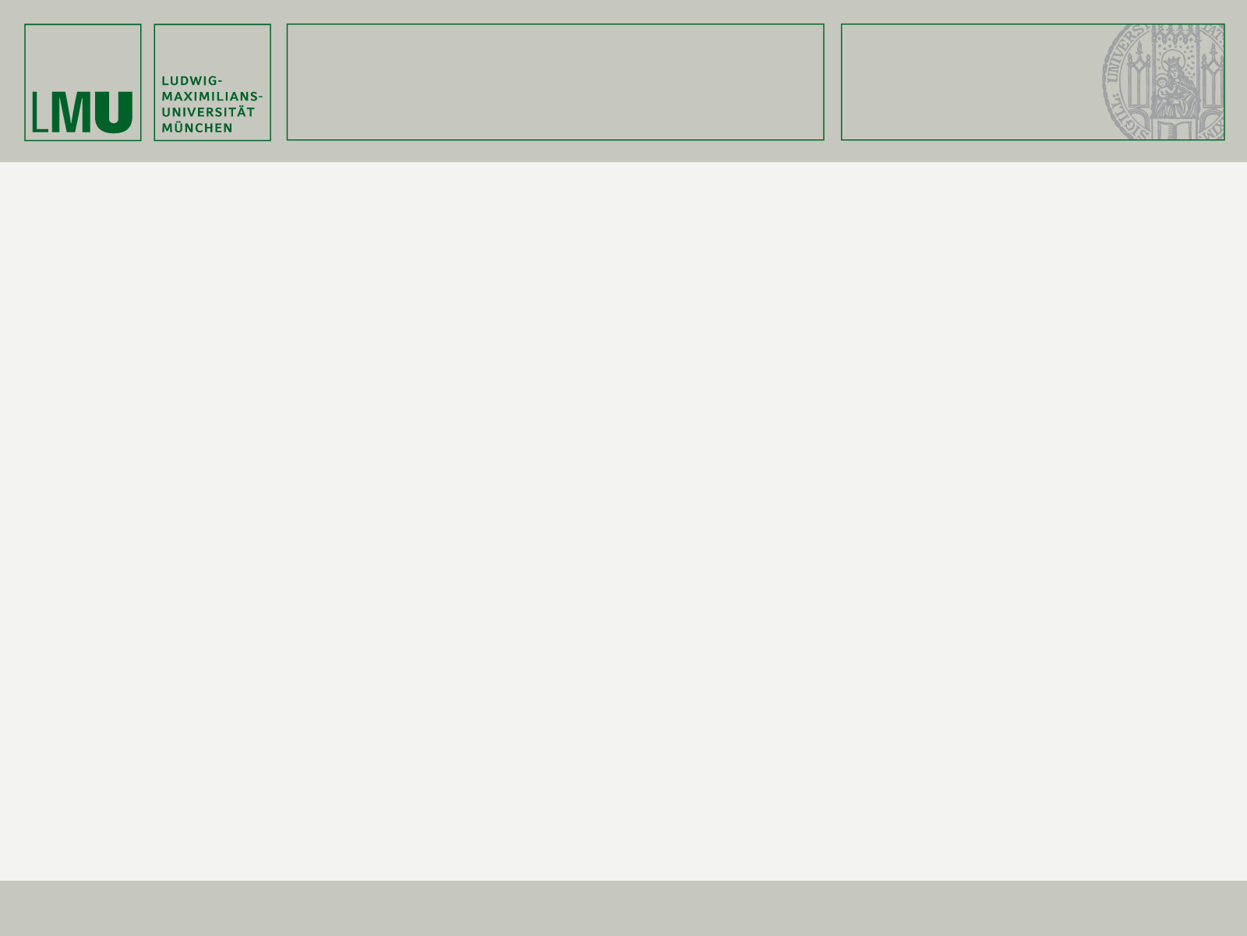
GESCHWISTER SCHOLL INSTITUTE
FOR POLITICAL SCIENCE
Study Program Coordination for the M.A. Political Science
Béatrice Alischer, M.A.
Room: 068
Phone: +49 89 2180 9033
Mail: masterstudiengang@gsi.uni-muenchen.de
2
Notes:
How many of you do not speak German?
How many of your are not enrolled in courses yet?
Are any of you not enrolled yet at all?

Slide 3
GESCHWISTER SCHOLL INSTITUTE
FOR POLITICAL SCIENCE
Student Assistant
For questions and problems with course registration
Irena Kitanovska
Raum: 066
Telefon: +49 89 2180 9106
Mail: studienbuero@gsi.uni-muenchen.de
3

Slide 4

GESCHWISTER SCHOLL INSTITUTE
FOR POLITICAL SCIENCE
4

Slide 5
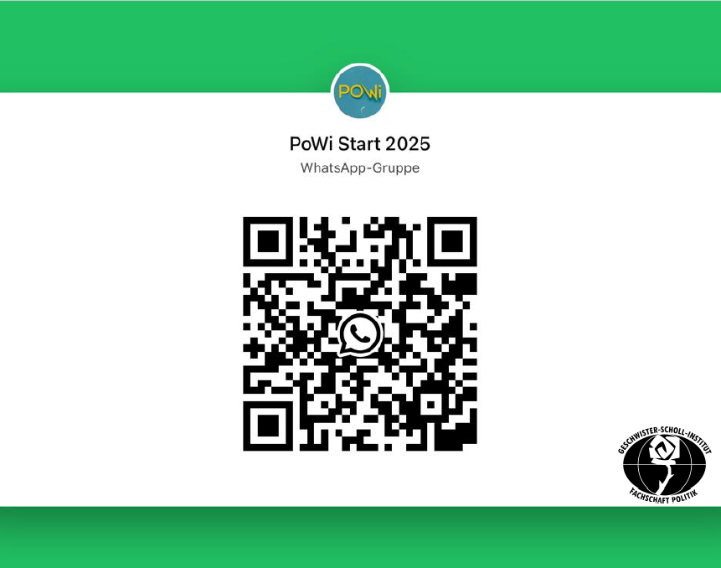
GESCHWISTER SCHOLL INSTITUTE
FOR POLITICAL SCIENCE
5

Slide 6

GESCHWISTER SCHOLL INSTITUTE
FOR POLITICAL SCIENCE
6

Slide 7
GESCHWISTER SCHOLL INSTITUTE
FOR POLITICAL SCIENCE
Program structure
120 ECTS points; no minor
Standard period of study: 4 terms
Maximum period of study: 7 terms, otherwise exmatriculated
Elective modules in the second and third term are divided into three focus areas (out of which you chose two):
Democratic Politics and Governance
Global and European Politics
Public Policy and Public Administration
7

Slide 8
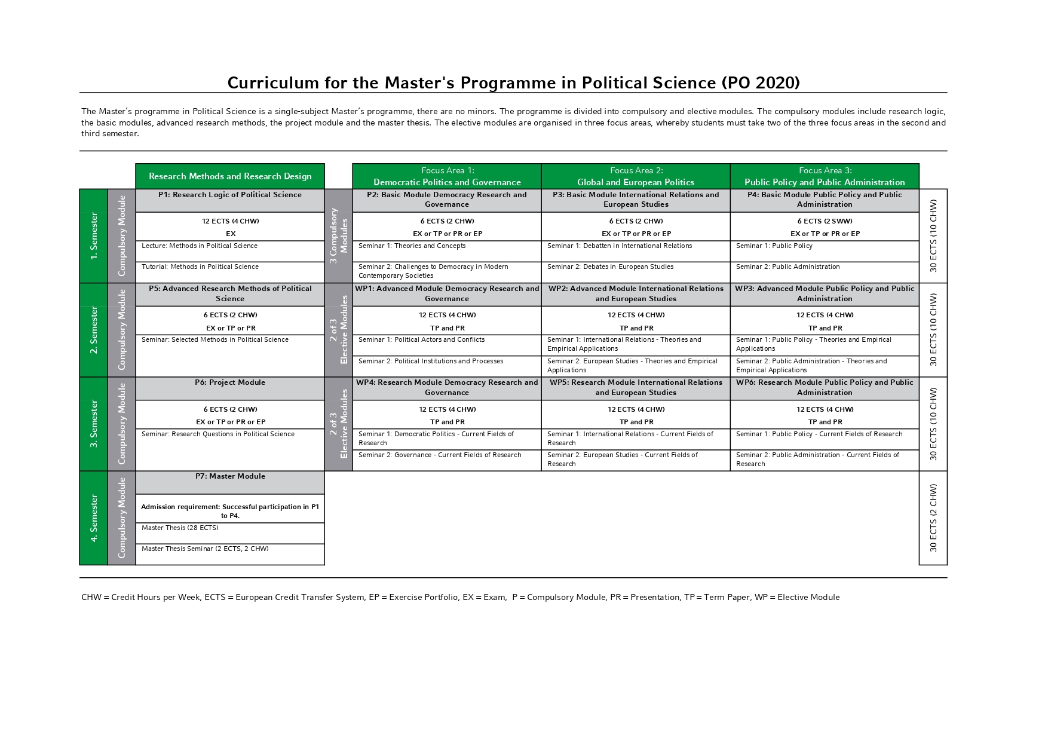

Slide 9
GESCHWISTER SCHOLL INSTITUTE
FOR POLITICAL SCIENCE
Program structure: Compulsory modules
Term
  P1: Research Logic of Political Science
  P2 – P4: Basic modules in all three focus areas
Term
  P5: Advanced Research Methods of Political Science
Term
  P6: Project Module
Term
  P7: Master Module; consisting of Master Thesis (23 weeks writing time) and Master Thesis Seminar
9
Notes:
Remember admission requirement for Master Module!

Slide 10
GESCHWISTER SCHOLL INSTITUTE
FOR POLITICAL SCIENCE
Program structure: Compulsory modules
1. Term (Winter) | P1 Research Logic of Political Science P2 – P4: Basic modules in all three focus areas
2. Term (Summer) | P5: Advanced Research Methods of Political Science
3. Term (Winter) | P6: Project Module
4. Term (Summer) | P7: Master Module consisting of Master Thesis (22 weeks writing time) and Master Thesis Seminar
10
Notes:
Remember admission requirement for Master Module!

Slide 11
GESCHWISTER SCHOLL INSTITUTE
FOR POLITICAL SCIENCE
Program structure: Elective modules
Term
  Two out of three focus areas; each consisting of two seminars
  Examnation: term paper AND presentation
Term
  Two out of three focus areas; each consisting of two seminars
  Examnation: term paper AND presentation
You may switch focus areas between your second and third term, although we do not recommend doing so, as specialization will help you in your MA thesis.
11

Slide 12
GESCHWISTER SCHOLL INSTITUTE
FOR POLITICAL SCIENCE
Courses to take in the first term
P1: Research Logic of Political Science
Lecture: Methods in Political Science
Tutorial: Methods in Political Science
P2: Basic Module Democracy Research and Governance
Seminar : Challenges to Democracy in Modern Contemporary Societies
P3: Basic Module International Relations and European Studies
Seminar: Debates in International Relations and European Studies
P4: Basic Module Public Policy and Public Administration
Seminar: Fundamentals of Public Policy and Public Administration
12

Slide 13
GESCHWISTER SCHOLL INSTITUTE
FOR POLITICAL SCIENCE
Organization of Studies
Enrolment for all courses is mandatory, 1-2 weeks before the start of term via LSF.
6th – 8th Oktober 2025
Registration for exams is mandatory, 7th-8th week of the lecture period via LSF (applies to exams, presentations, term papers and graded exercises).
5th – 7th January 2026
Important documents
Curriculum
Studien- und Prüfungsordnung (Study and examination regulations)
13

Slide 14
GESCHWISTER SCHOLL INSTITUTE
FOR POLITICAL SCIENCE
Examinations during your studies
P1: Lecture and tutorial are examined together in a written exam.
P2-P4: In each module, one of the following performances is required: Presentation, written exam, term paper or exercise portfolio.
Elective modules: The elective modules consist of two seminars each, in which a total of two partial performances must be achieved: A term paper as well as a presentation or written exam or an exercise portfolio.
Each examination can be repeated once if the student fails.
14

Slide 15
GESCHWISTER SCHOLL INSTITUTE
FOR POLITICAL SCIENCE
Examinations during your studies
The final grade is calculated from the individual grades weighted according to the ECTS points; all performances are included in the final grade.
Modules can be shifted in the course of study, but only in the annual cycle. Example: From the 1st to the 3rd semester. Keep in mind the maximum duration of study.
Regular attendance is not checked, but is essential for passing exams.
Good grades are important for scholarship applications (e.g. Deutschlandstipendium, Studienstiftung).
15

Slide 16
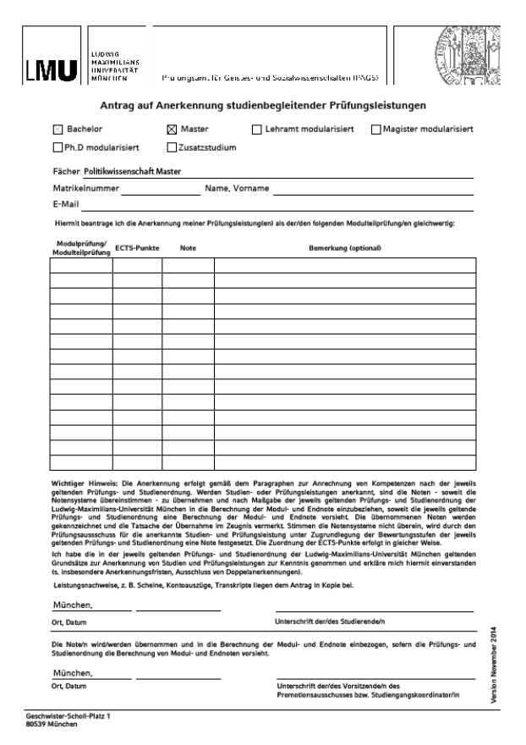
GESCHWISTER SCHOLL INSTITUTE
FOR POLITICAL SCIENCE
Course Recognition
Courses completed in a master's degree program BEFORE the start of the program: Recognition possible only during the first term of study.
Courses completed DURING the course of study: Recognition only possible during the following term.
Please come to my office hours for recognition of your achievements.
Send an email beforehand with the following information: Name and content of course, grade, examination type (i.e. essay, presentation, etc.)
16

Slide 17
GESCHWISTER SCHOLL INSTITUTE
FOR POLITICAL SCIENCE
Examination Office
Tasks
Registration for exams
Withdrawal from exams with a certificate
Issuance of the transcript, the final MA documents as well as the BAföG certificate
Contact
Ralf Lechermann
Room: HGB, D 020
Phone: +49 89 2180 6235
Mail: ralf.lechermann@verwaltung.uni-muenchen.de
17

Slide 18
GESCHWISTER SCHOLL INSTITUTE
FOR POLITICAL SCIENCE
Study abroad
ERASMUS (EU exchange program)
  Numerous partner universities in various European countries, ideally in the third semester with leave of absence
  Application in the 1st term: January 15, 2025
  Contact: Benedikt Kastner, M.A.
LMUexchange scholarships
  e.g. USA, Canada, China, Mexico, Thailand, Ecuador
  Application in the 1st semester: November 15, 2024
  Contact: Benedikt Kastner, M.A.
„On your own“
  e.g. with DAAD scholarship, information at the International Office
18

Slide 19
GESCHWISTER SCHOLL INSTITUTE
FOR POLITICAL SCIENCE
Internships
No mandatory internships are provided.
Voluntary internships during your studies are strongly encouraged.
Contact us if you need confirmation for endorsement and support of voluntary internships (e.g. for leave of absence at LMU).
Further information can be found in the internship guide.
Contact person: Dr. Tanja Zinterer
19

Slide 20
GESCHWISTER SCHOLL INSTITUTE
FOR POLITICAL SCIENCE
Important Resources
Moodle
Moodle for MA Political Science Students (Password: MAPolSci)
Moodle für Arbeitstechniken (Password: GSI)
Twitter/X @GSI_Muenchen
20

Slide 21
GESCHWISTER SCHOLL INSTITUTE
FOR POLITICAL SCIENCE
Extracurricular activities
NMUN
Environmental Studies Certificate Program
Intercultural Communication Certificate Programme
21

Slide 22
GESCHWISTER SCHOLL INSTITUTE
FOR POLITICAL SCIENCE
Other support options
Ment15: Mentoring program for female undergraduate and graduate students in Faculty 15.
Protestant Student Community
22

Slide 23
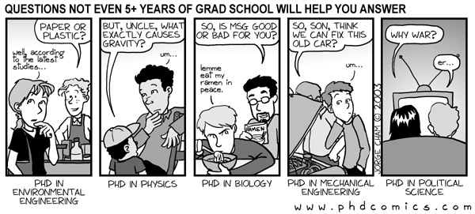
GESCHWISTER SCHOLL INSTITUTE
FOR POLITICAL SCIENCE
Questions?
23

